Slide 1
C# Bootcamp
{ Module 4: Namespaces, Polymorphism, Operator Overloading }
Date will go here

Slide 2
Module Objectives
Learn the major features of object-oriented languages
Design and develop multitier applications using component-based development methods
Use inheritance to extend the functionality of user-defined classes
Become aware of partial classes
Design and implement interfaces
Understand why polymorphic programming is a common goal in .NET

Slide 3
Object-Oriented Language Features

Slide 4
OBJECT-ORIENTED LANGUAGE FEATURES
Object-Oriented Language Features
For a language to be considered a true object-oriented programming (OOP) language, it must support the following four major concepts, which C# and the .NET platform embrace:
Abstraction
Abstract or identify the objects involved in the problem
Encapsulation
Packaging data and behaviors into a single unit, thus hiding implementation details.
Inheritance
enable reuse of code through extending the functionality of the program units
Polymorphism
Multiple implementations of the same behaviors so that the appropriate implementation can be executed based on the situation

Slide 5
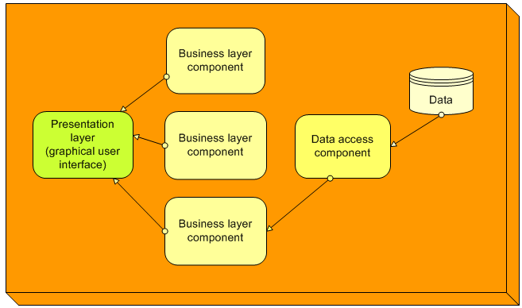
Component-Based Development
Object-Oriented Language Features

Slide 6
Component-Based Development
Object-Oriented Language Features
Multitier applications
Data access tier for accessing data from text files and databases
Graphical user interface tier for user interaction
Windows
Web
Components implemented through classes in C#
Class library files with a dynamic link library (DLL) extension

Slide 7
Inheritance
Object-Oriented Language Features
Enables you to:
Create a general class and then define specialized classes that have access to the members of the general class
Associated with an "is a" relationship
Specialized class “is a” form of the general class
Classes can also have a "has a" relationship, not associated with inheritance
"has a" relationship associated with containment or aggregation

Slide 8
Creating Base Classes for Inheritance
Object-Oriented Language Features
Can define your own classes from which other classes can inherit
Base class is called the super or parent class
Data members are defined with a private access modifier
Constructors are defined with public access modifiers
Properties offer public access to data fields

Slide 9
Overriding Methods
Object-Oriented Language Features
Replace the method defined at a higher level
Keyword override included in derived class
Base method includes virtual, abstract, or override keyword
Overriding differs from overloading a method
Overridden methods have exactly the same signature
Overloaded methods each have a different signature
Example of polymorphism
Derived classes inherit from a base class
Also called subclasses or child classes
Protected access modifiers
Access only to classes that derived from them
Access to change data in the base class

Slide 10
Overriding Methods
Object-Oriented Language Features
Replace the method defined at a higher level
Keyword override included in derived class
Base method includes virtual, abstract, or override keyword
Overriding differs from overloading a method
Overridden methods have exactly the same signature
Overloaded methods each have a different signature
Example of polymorphism
Derived classes inherit from a base class
Also called subclasses or child classes
Protected access modifiers
Access only to classes that derived from them
Access to change data in the base class

Slide 11
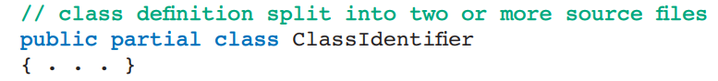
Partial Classes
Object-Oriented Language Features
Break class up into two or more files
Each file uses partial class designation
You can take advantage of this new feature and spread the definition of your classes over multiple files.
At compile time, the files are merged together.
This might be useful if you were working on a large project and wanted to spread the work among multiple programmers.

Slide 12
Polymorphism
Object-Oriented Language Features
Ability for classes to provide different implementations of methods called by the same name
Dynamic binding
Determines which method to call at run time based on which object calls the method
The word polymorphism means having many forms.

Slide 13
Polymorphism
Object-Oriented Language Features
Real world example of Polymorphism
Example 1:
A teacher behaves with student.
A teacher behaves with his/her seniors.
Here, teacher is an object but the attitude is different in different situations.
Example 2:
A person behaves as a SON in house, at the same time that person behaves like an EMPLOYEE in the office.
Example 3:
Your mobile phone, one NAME but many FORMS:
As phone
As camera
As mp3 player
As radio

Slide 14
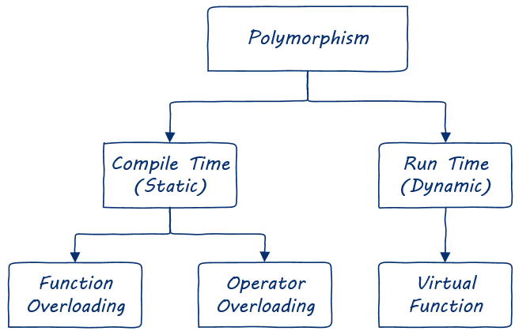
Polymorphism
Object-Oriented Language Features
There are two type of polymorphism:
Static or Compile time polymorphism
Dynamic or Runtime polymorphism

Slide 15
Static or Compile time polymorphism
Object-Oriented Language Features
In static polymorphism, the decision is made at compile time.
The mechanism of linking a function with an object during compile time is called early binding. It is also called static binding.
Which method is to be called is decided at compile-time only.
C# provides two techniques to implement static polymorphism.
They are:
Function Overloading;
Operator Overloading

Slide 16
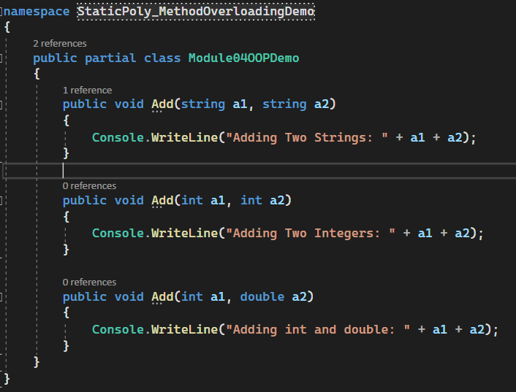
Function Overloading
Object-Oriented Language Features
Function overloading is a concept where a class can have more than one method with the same name and different parameters.
Compiler checks the type and number of parameters passed on to the method and decides which method to call at compile time and it will give an error if there are no methods that match the method signature of the method that is called at compile time.

Slide 17
Operator Overloading
Object-Oriented Language Features
You can redefine or overload most of the built-in operators available in C#.
Thus a programmer can use operators with user-defined types as well.
Overloaded operators are functions with special names the keyword operator followed by the symbol for the operator being defined.
Similar to any other function, an overloaded operator has a return type and a parameter list.

Slide 18
Dynamic or Runtime Polymorphism
Object-Oriented Language Features
Run-time polymorphism is achieved by function overriding and virtual function.
When you have a function defined in a class that you want to be implemented in an inherited class(es), you use virtual functions.
The virtual functions could be implemented differently in different inherited class and the call to these functions will be decided at runtime.

Slide 19
Virtual Functions
Object-Oriented Language Features
One of the most important aspects of polymorphism is the idea of a virtual function.
A virtual function basically allows you to define a function in a base class and then change it later on.
The virtual keyword is used to modify a method, property, indexer or event declaration, and allow it to be overridden in a derived class.
When a virtual method is invoked, the run-time type of the object is checked for an overriding member.
The overriding member in the most derived class is called, which might be the original member, if no derived class has overridden the member.

Slide 20
Virtual Functions
Object-Oriented Language Features
Remember!
By default, methods are non-virtual. You cannot override a non-virtual method.
You cannot use the virtual modifier with the static, abstract, private or override modifiers.
It is an error to use the virtual modifier on a static property.
A virtual inherited property can be overridden in a derived class by including a property declaration that uses the override modifier.

Slide 21
Demo

Slide 22



Questions?

Slide 23
Thank you

